Slide 1

The Data Visualization Solution Dan Melcher Sr. RIA Architect
Notes:
Data visualization advancements must take place to transform large data sets into visual, actionable intelligence.

Slide 2
Agenda
Visualizations must augment the message, not overshadow it
Actuate BIRT 360 Dashboards
10 jaw-dropping visualizations
Attributes highlighted
Applications must bring messages within visualizations together into something meaningful
Actuate BIRT 360 Scorecards
3 visualizations with combined meaningful messages
Analytic visualizations enable actionable intelligence
Actuate BIRT Analytics
3 powerful analytic visualizations
Notes:
Since it’s Data Visualization Day today, I will be talking about the what makes good data visualizations. I won’t be giving a product demo, but will be showing and discussing the data visualizations from within the Actuate products.

Slide 3
Agenda
Visualizations must augment the message, not overshadow it
Actuate BIRT 360 Dashboards
10 jaw-dropping visualizations
Attributes highlighted
Applications must bring messages within visualizations together into something meaningful
Actuate BIRT 360 Scorecards
3 visualizations with combined meaningful messages
Analytic visualizations enable actionable intelligence
Actuate BIRT Analytics
3 powerful analytic visualizations
Notes:
Similar to how a musician must augment the song, not just blare away and overshadow the mood, timbre and tempo of the song, visualizations must augment the message, not overshadow it.
I’ll be showing data visualizations from Actuate, Google and an open source library called d3. Actuate’s BIRT 360 Dashboard product even allows third-party visualizations to be shown after being wired up to BIRT data sources in a BIRT design.

Slide 4
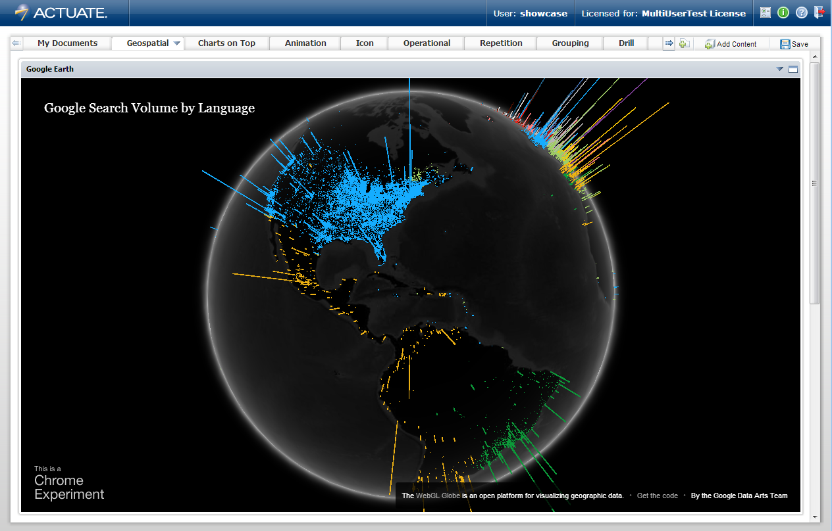
Geospatial
Notes:
The bar length shows volume and the color denotes language. No legend is displayed that takes up valuable real estate that can be used by the visualization. Only the data has color because it’s the most important thing.

Slide 5
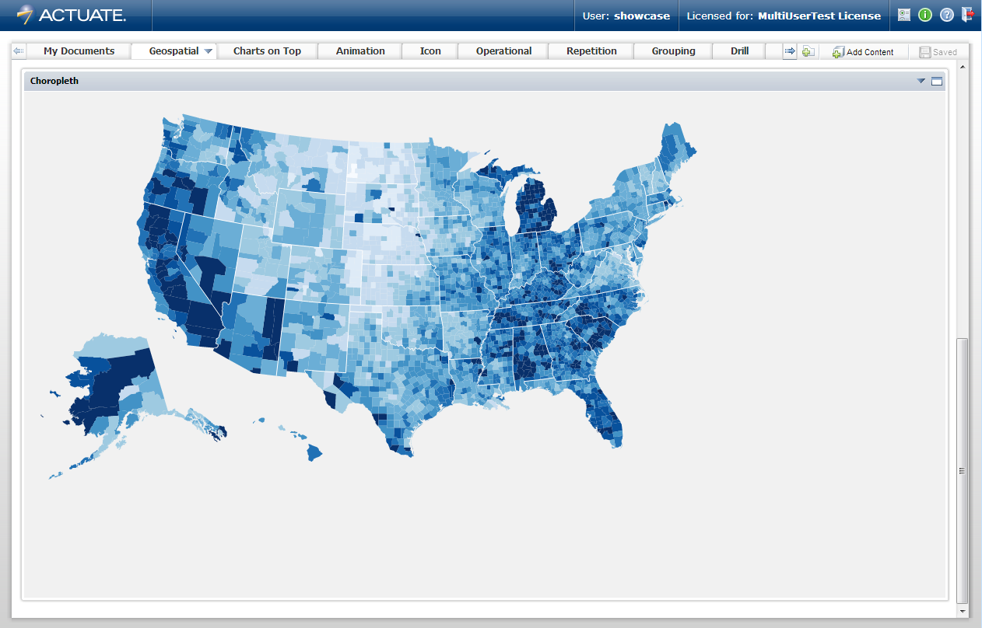
Geospatial
Notes:
Monochrome color blue for the data. Darker blue for high unemployment to gradient of lighter blue for lower unemployment. State borders have no color, same as background. Eliminated chart junk. Nothing extra to detract from message of data. Data is all we see.

Slide 6
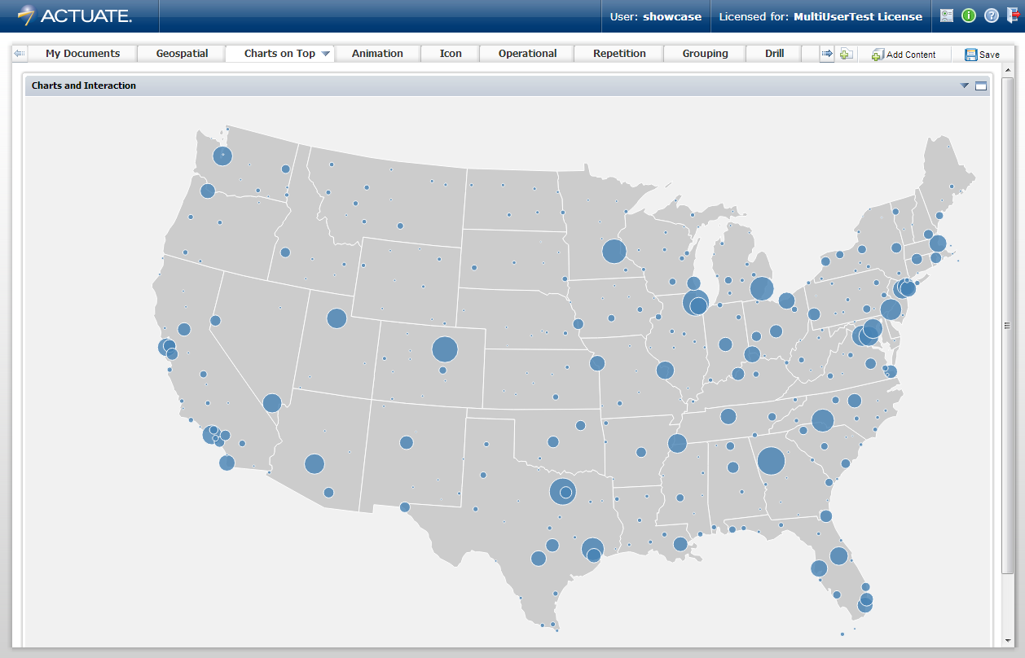
Charts on Top
Notes:
Airport longitude and latitude for placement of bubble chart on top of map.

Slide 7
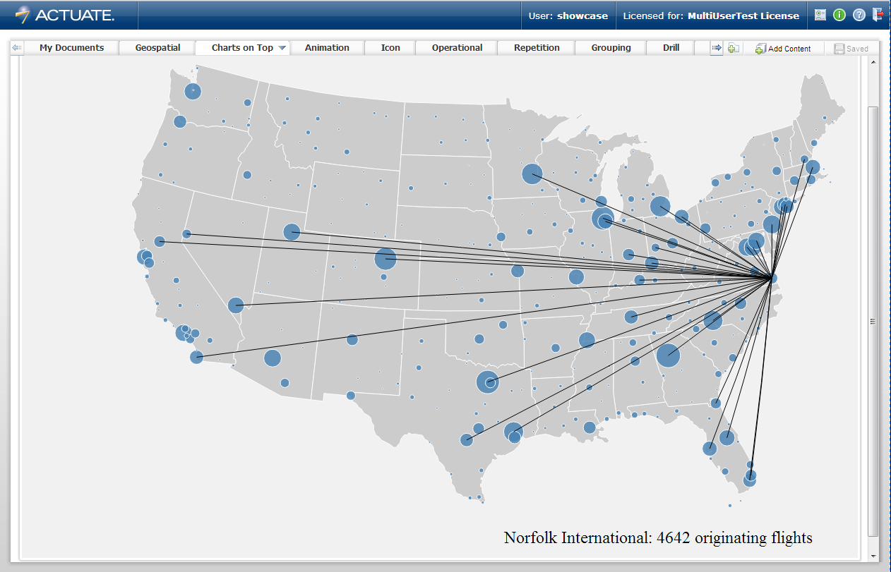
Interaction
Notes:
Interaction is another attribute of a good data visualization. Hover over airport bubble shows number of flights in lower right with airport name and black lines on chart showing origin-destinations. Black lines show data and don’t conflict with anything else in visualization, like state borders.

Slide 8
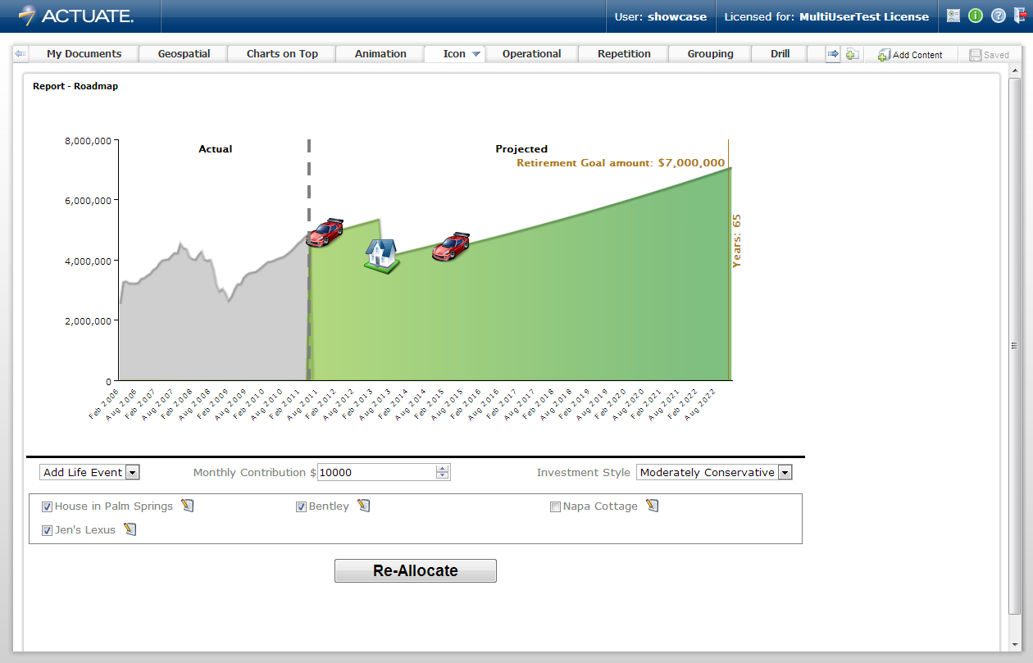
Icon
Notes:
Use of good icons eliminate the need for a chart legend that takes valuable real estate from the visualization. There is no misunderstanding the purchase of a car versus the purchase of a house in this visualization.

Slide 9
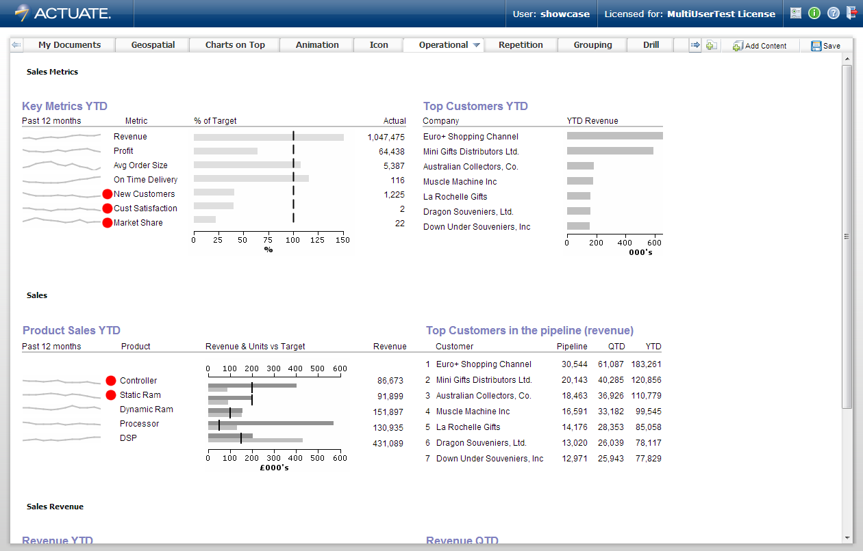
Rich
Notes:
Richness is another good data visualization attribute. Doing the squint test, your eye is automatically drawn to the red dots. This is where your attention should be to start your analysis on this operational dashboard.

Slide 10
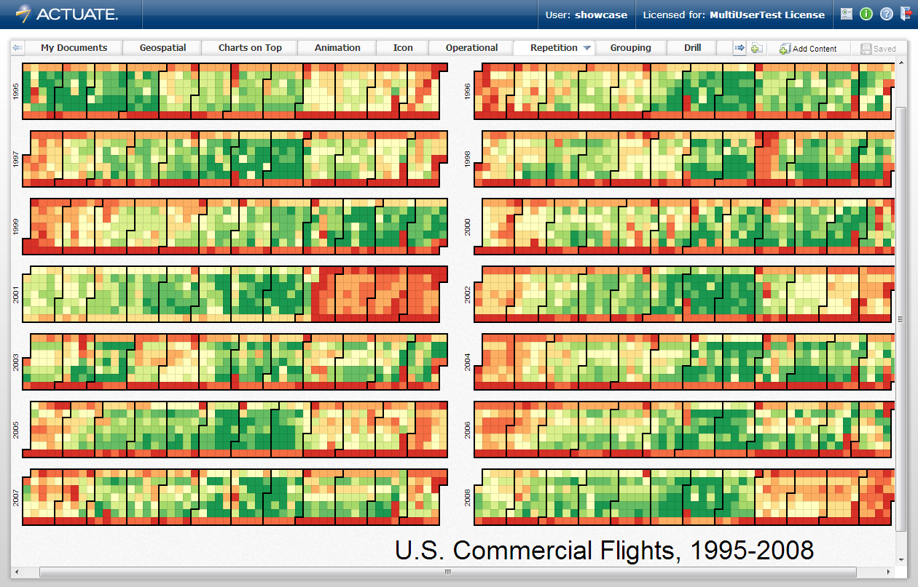
Repetition
Notes:
One of the most powerful big data visualization attribute is repetition. You only need to figure out the pattern once. It then can be applied to all 14 years, 12 month patterns in the year, 4+ columns of weeks in the month, 7 squares in the week with color coding showing on-time performance.

Slide 11
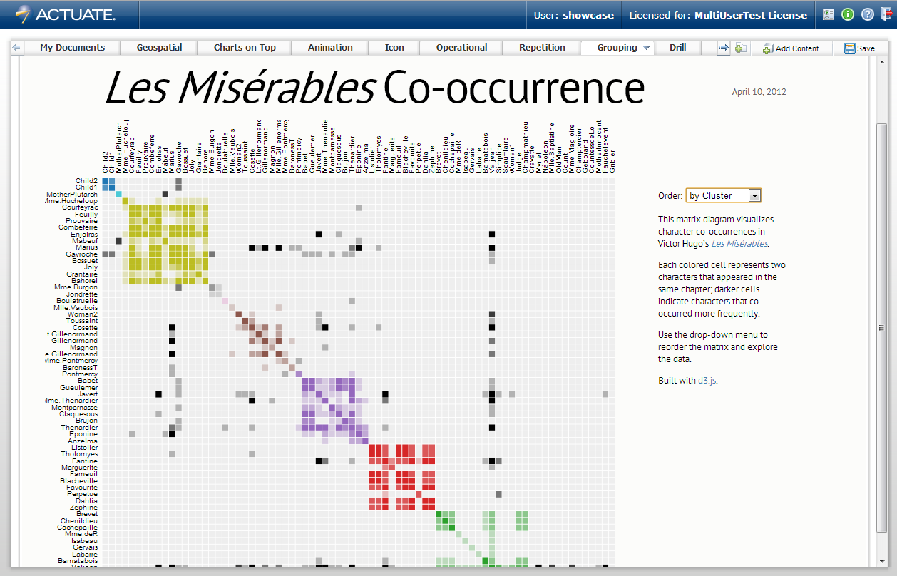
Grouping
Notes:
Grouping is another attribute that helps show relationship among large amounts of data. Especially data grouped by frequency and cluster.

Slide 12
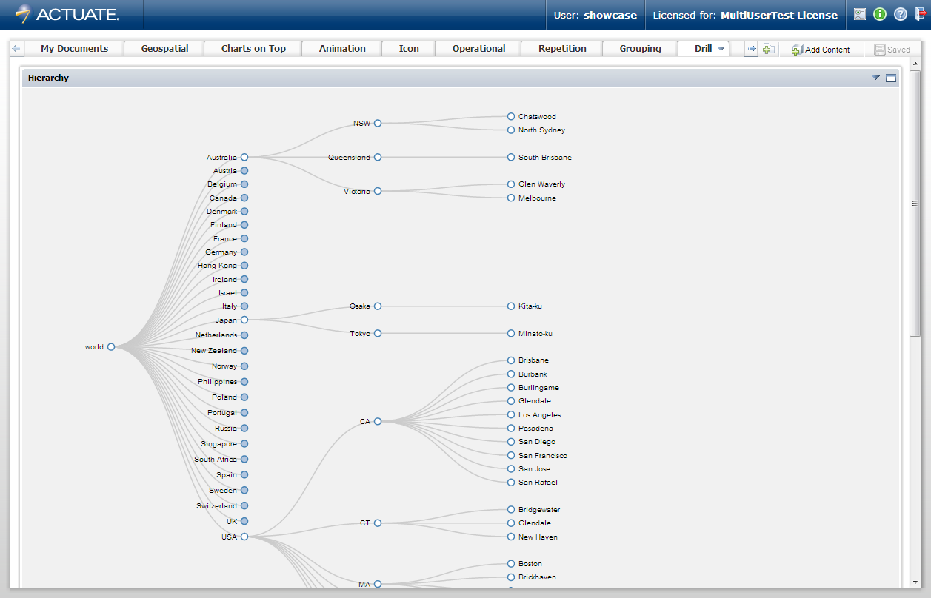
Drill
Notes:
Drill to detail is another useful data visualization attribute. Instead of popping up a new window or replacing the current visualization, this hierarchical visualization redraws itself to accommodate the detail at the lower levels.

Slide 13
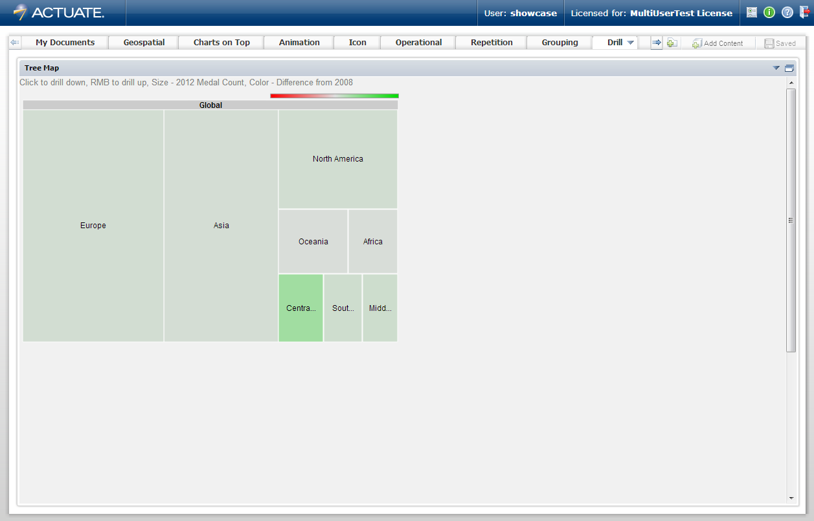
Drill
Notes:
The treemap is a fantastic big data visualization that represents lots of data and allows drill to detail underneath. The rectangle size denotes volume of measurement and color denotes difference since the previous measurement.

Slide 14
Agenda
Visualizations must augment the message, not overshadow it
Actuate BIRT 360 Dashboards
10 jaw-dropping visualizations
Attributes highlighted
Applications must bring messages within visualizations together into something meaningful
Actuate BIRT 360 Scorecards
3 visualizations with combined meaningful messages
Analytic visualizations enable actionable intelligence
Actuate BIRT Analytics
3 powerful analytic visualizations
Notes:
Just as an orchestra conductor brings musicians together and coordinates their efforts to make sure the mood, timbre and beauty of the song is effectively portrayed, an application must bring messages within visualizations together into something meaningful.

Slide 15
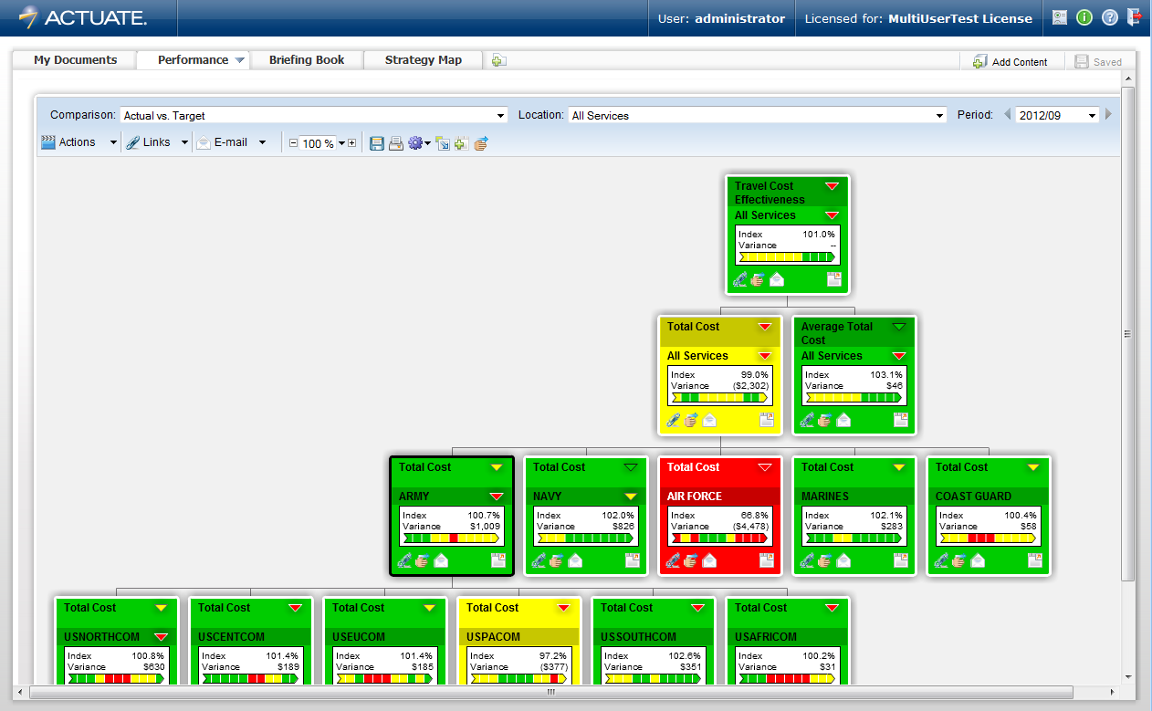
Performance
Notes:
Here, the BIRT 360 Scorecard application has many coordinated visualizations that combine messages about performance at many level of your organizations hierarchy into meaningful, targeted views.

Slide 16
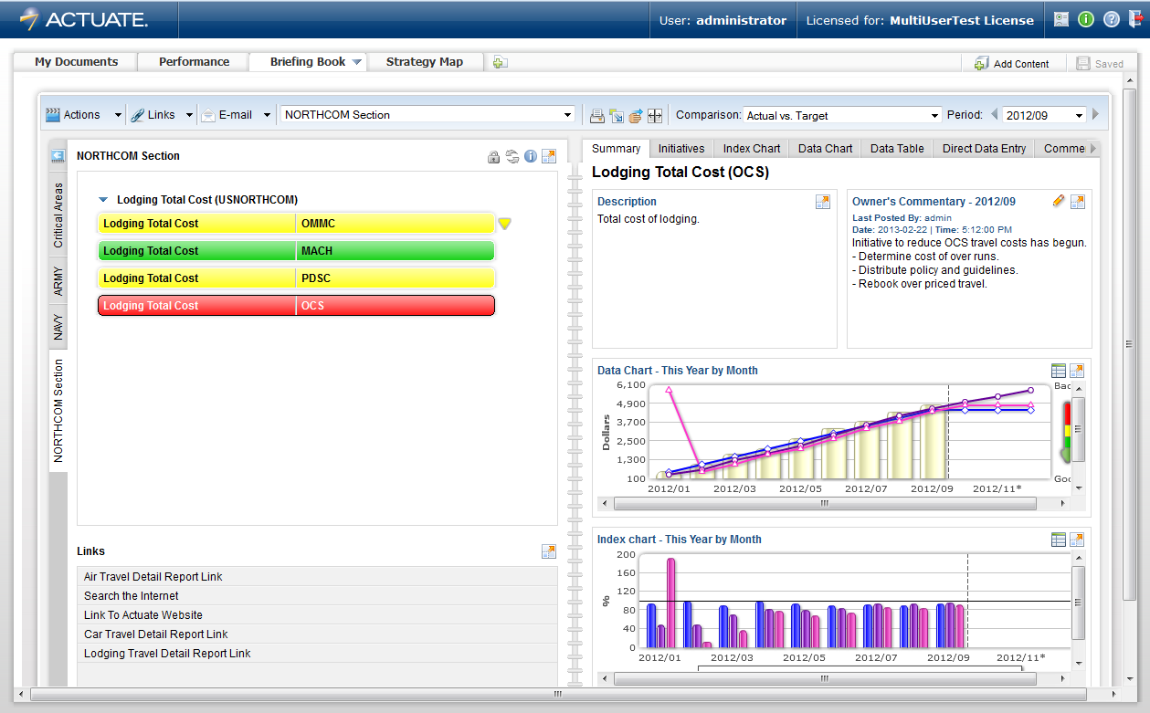
Briefing Book
Notes:
The same hierarchical performance metric messages can also be displayed in a different visualization, in the form of a briefing book.
An editable description section and commentary section allow for descriptive annotations to be shared with others. The initiatives section allow for actionable items to be entered and tracked.

Slide 17
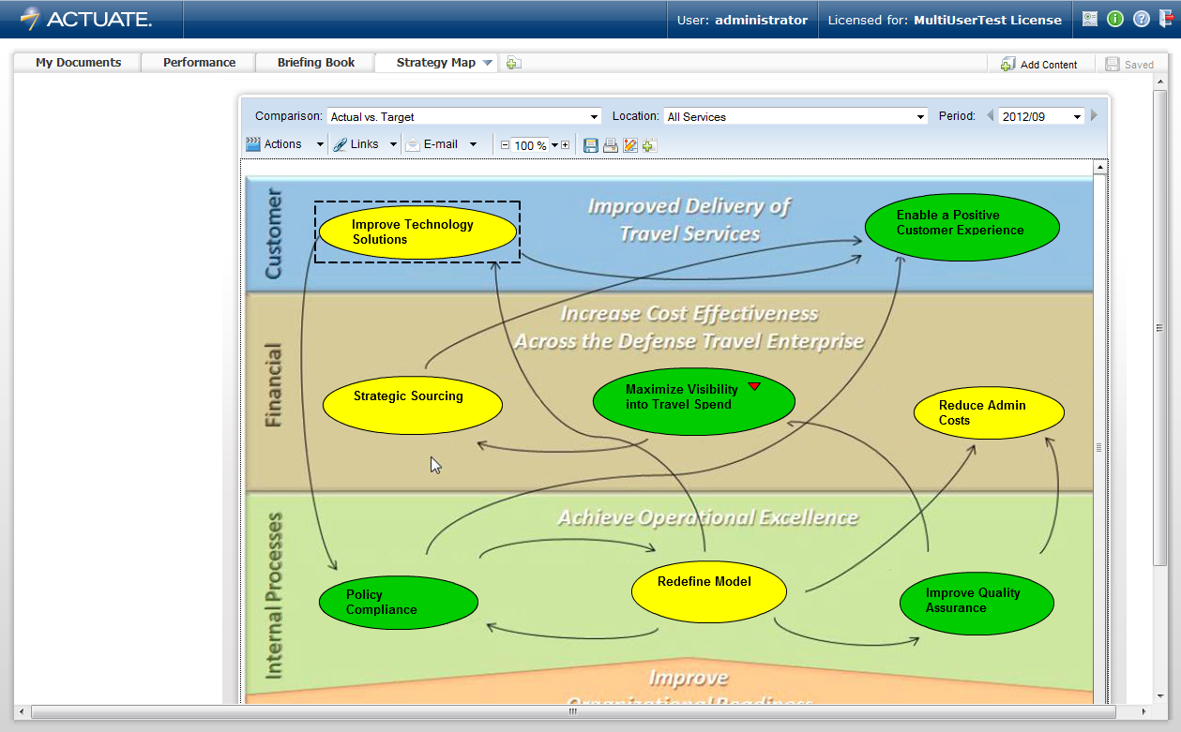
Strategy Map
Notes:
Performance metrics can be displayed right on top of your existing strategy map, with statuses showing current status against targets, previous year or previous month.
This visualization show the metric status on top of your already defined strategic objects that shows how these objectives are interrelated.

Slide 18
Agenda
Visualizations must augment the message, not overshadow it
Actuate BIRT 360 Dashboards
10 jaw-dropping visualizations
Attributes highlighted
Applications must bring messages within visualizations together into something meaningful
Actuate BIRT 360 Scorecards
3 visualizations with combined meaningful messages
Analytic visualizations enable actionable intelligence
Actuate BIRT Analytics
3 powerful analytic visualizations
Notes:
Analytic visualizations are an integral part of workflow involving exploration of data, discovery of hidden relationships and analysis to determine actionable intelligence.

Slide 19
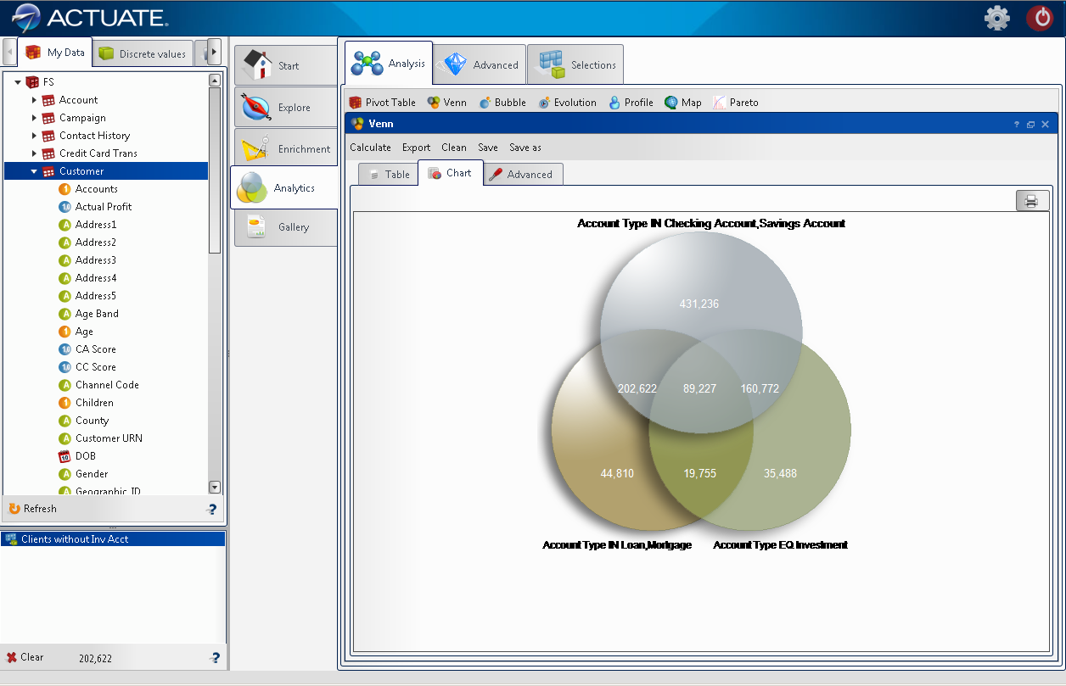
Venn Diagram
Notes:
In BIRT Analytics, the Venn Diagram is an excellent visualization to uncover hidden relationships from an overview perspective, and create a reusable filter by clicking on an intersection area within the diagram.

Slide 20
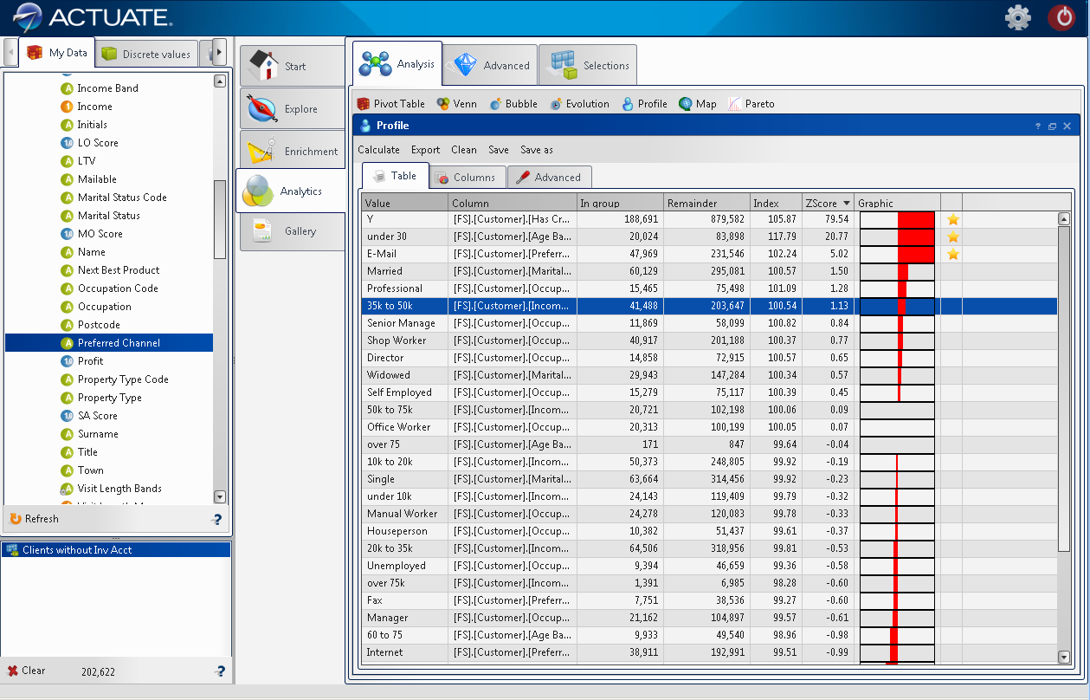
Profile
Notes:
The reusable filter can now be applied to all area of analysis, including the profile. The profile visualization shows us which data attribute values have the most influence. More red to the right indicates a stronger influence than red to the left.

Slide 21
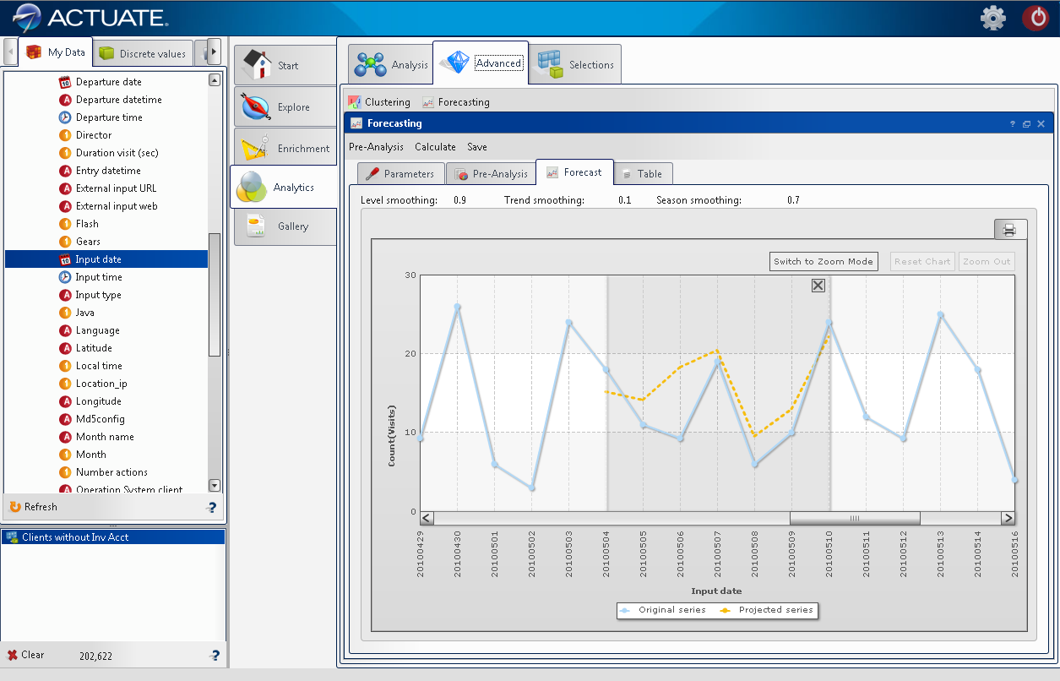
Predictive Analytics
Notes:
Visualization in predictive forecasting plays an interactive role in showing how our predicted values match up over our historical values. We can use this to uncover trends, anolamies, and make recommendations upon our findings.

Slide 22
Dan Melcher – dmelcher@actuate.com Twitter: @danmelcher www.actuate.com
Thanks for your attention
Notes:
These data visualization advancements can be used in your applications to transform your large data sets into visual, actionable intelligence.

